Slide 1
Race categorization task
Fixation
Study 1-ERPfix
eyes
forehead
4
eyes
forehead
(ms)
P2 amplitude (µV)
3
2
Notes:
Add separate legend for P2 amp
Change dots for different levels of fix
Move P2 amp up, truncate axis so they don’t overlap
Change color

Slide 2
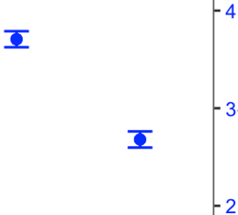
Race-categorization task
P2 amplitude (µV)
Notes:
Add separate legend for P2 amp
Change dots for different levels of fix
Move P2 amp up, truncate axis so they don’t overlap
Change color

Slide 3
Study 2- RaceGen
Race categorization task
Gender categorization task
Target Gender
Target Gender
4
female
male
female
male
female
male
female
male
(ms)
P2 amplitude (µV)
3
2

Slide 4
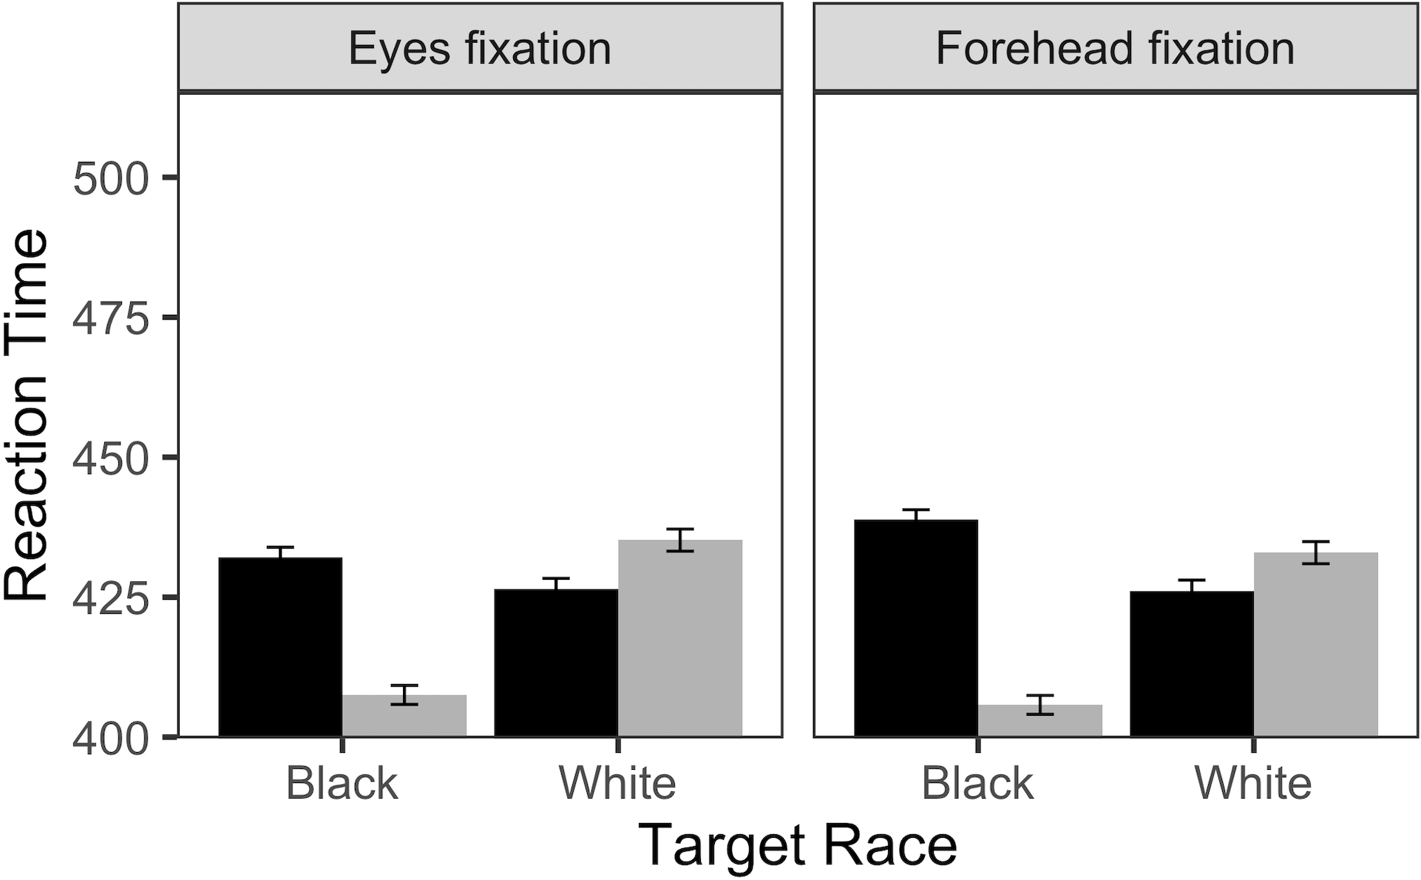
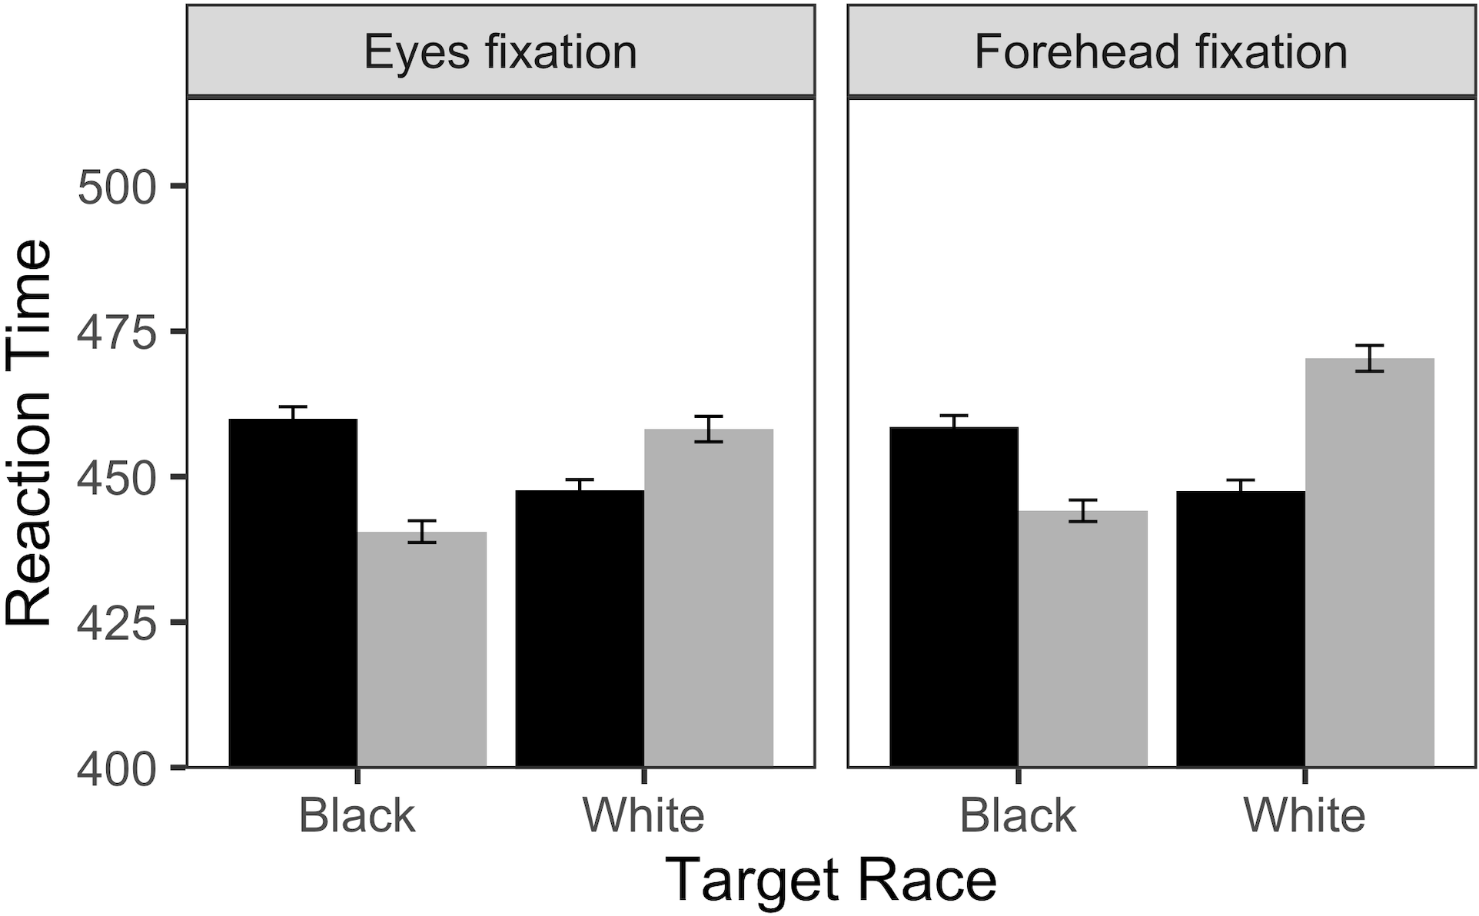
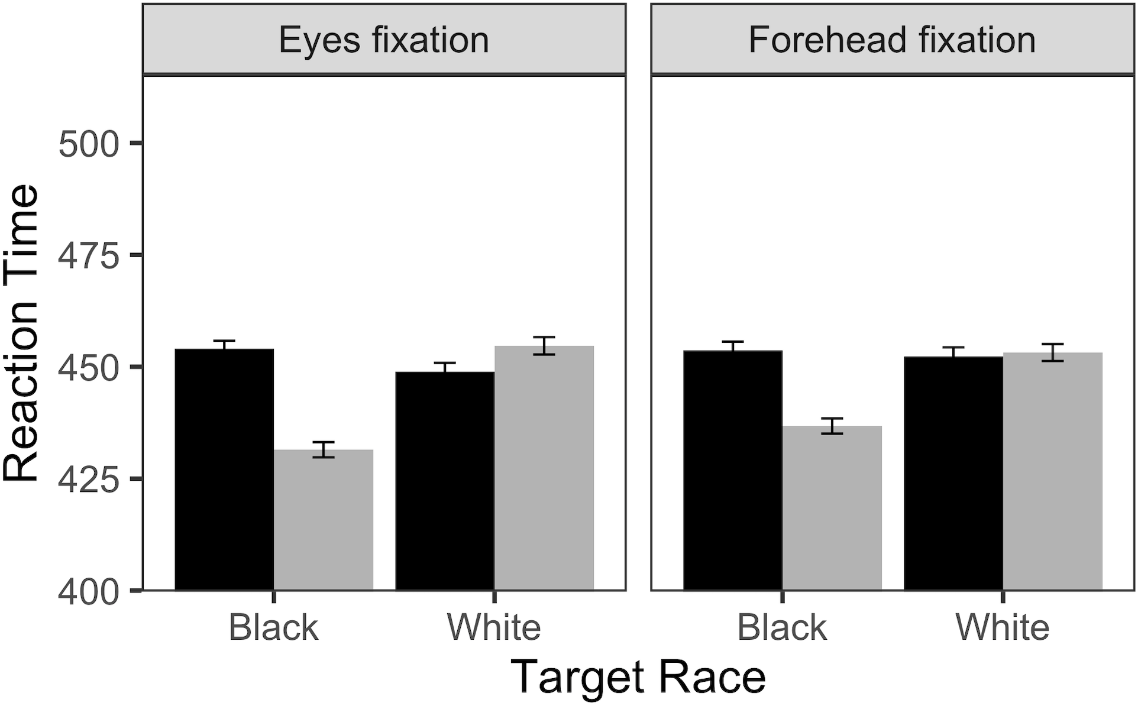
Black participants
Race categorization task
Gender categorization task
(ms)
3
P2 amplitude (µV)
2
1
Target Gender
female
male
White participants
female
male
Race categorization task
Gender categorization task
(ms)
5
4
P2 amplitude (µV)
3

Slide 5
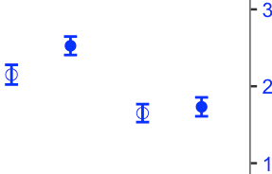
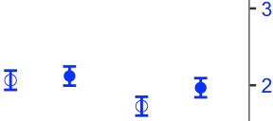
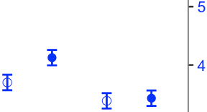
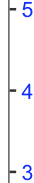
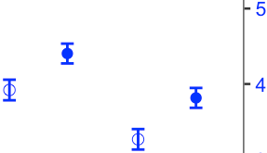
Black participants
Race-categorization task
Gender-categorization task
(ms)
P2 amplitude (µV)
Target Gender
White participants
female
male
Race-categorization task
Gender-categorization task
female
male
(ms)
P2 amplitude (µV)

Slide 6
Study 3- Diss
Race-categorization task
Gender-categorization task
Target Gender
female
male
female
male
3
(ms)
475
P2 amplitude (µV)
2
Reaction Time
450
425
Black
White
Black
White
Target Race

